Slide 1
Fitting Complex Functions
Part 1B

Slide 2
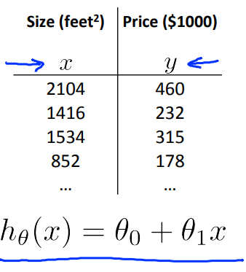
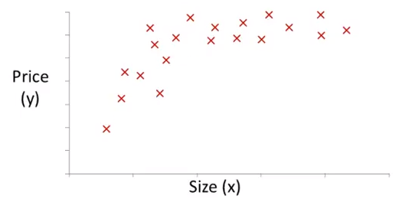

Polynomial Regression

Slide 3
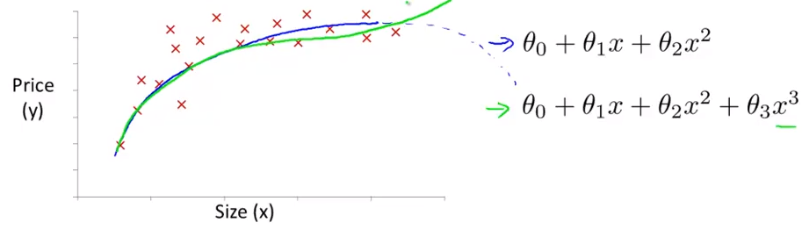

Slide 4
Quadratic h(x)
h(x) = 𝛳₀ + 𝛳₁x₁ + 𝛳₂x₂
= 𝛳₀ + 𝛳₁x + 𝛳₂x²
Cubic h(x)
h(x) = 𝛳₀ + 𝛳₁x₁ + 𝛳₂x₂ + 𝛳₃x₃
= 𝛳₀ + 𝛳₁x + 𝛳₂x² +𝛳₃x³

Slide 5
Regularisation

Slide 6
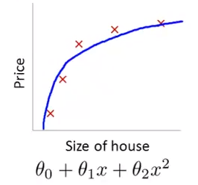
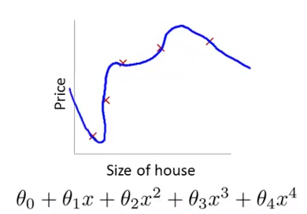

Slide 7
Penalize 𝛳₃ and 𝛳₄ by making it small- How?
J(𝛳) = 1/2m (𝚺_{i=1 to n}(h(x^{(i)})- y^{(i)})²) + 1000𝛳₃² +1000𝛳₄²

Slide 8
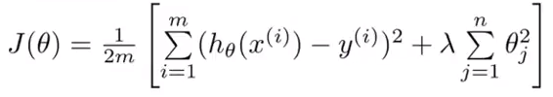
Modified Cost Function

Slide 9
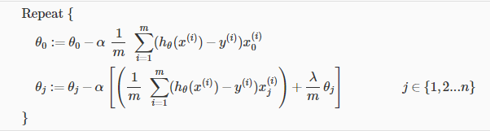
Gradient Descent

Slide 10
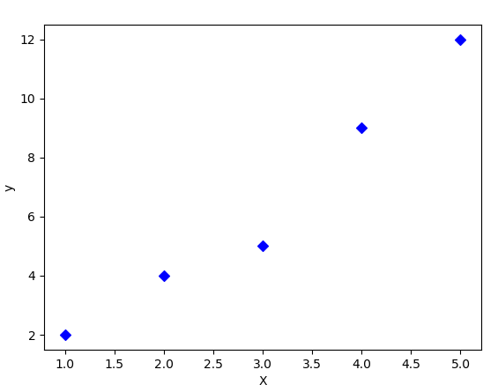
lambda intuition

Slide 11

The Extra Bit

